Slide 1


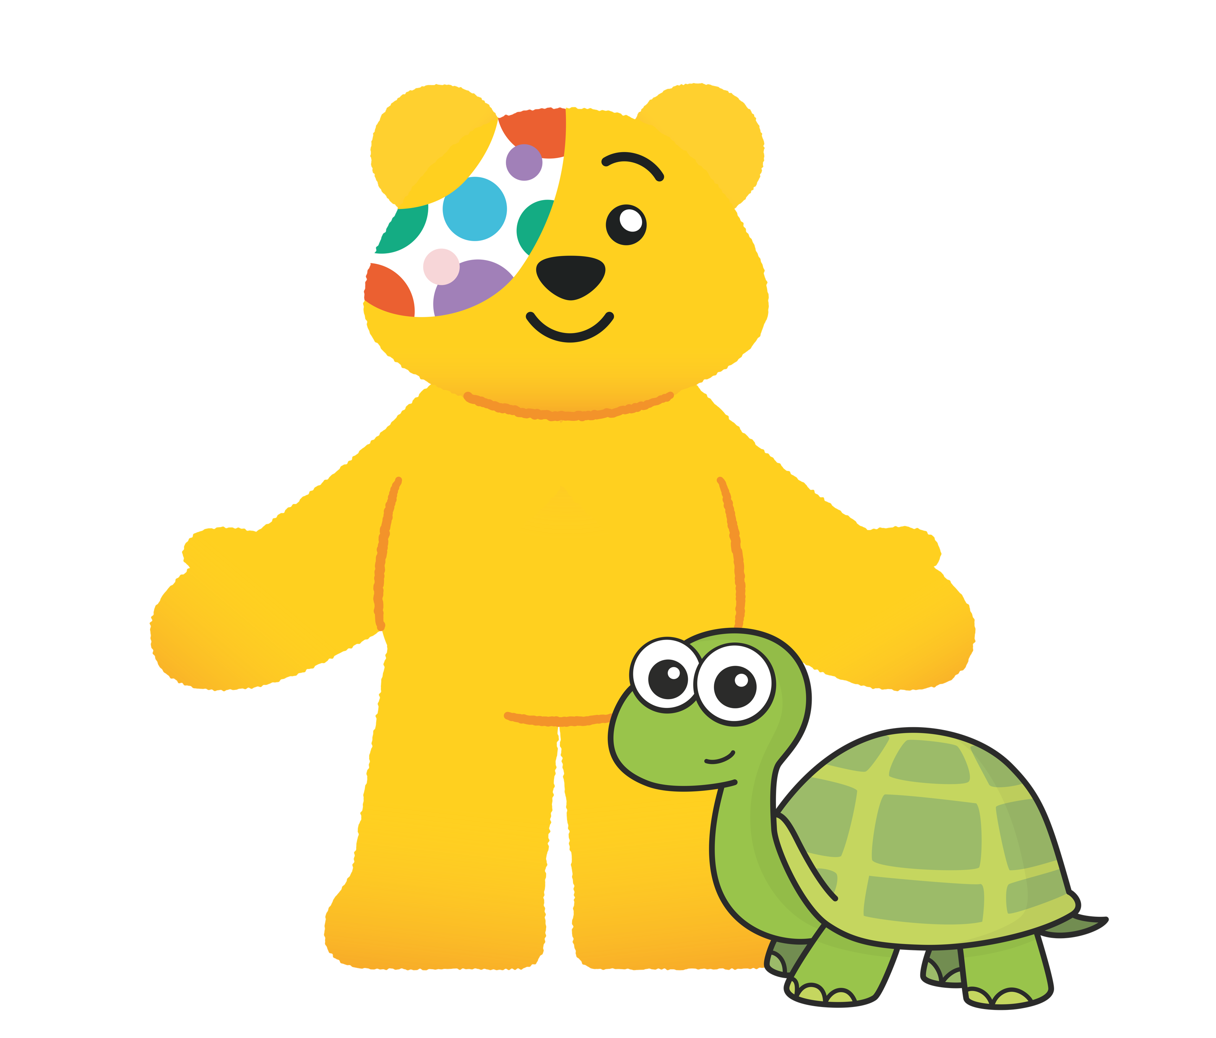


Slide 2
Guidance for teachers
These slides contain 5 daily maths challenges that can be used in the run up to BBC Children in Need day (Friday 15th November 2024). It would be useful to have coins available for some of the challenges so children can work practically.
Each challenge is followed by a page of suggested discussion prompts to raise children’s awareness of those needing help and how BBC Children in Need can make a difference.
The final discussion prompt encourages schools to consider how they could support BBC Children in Need. You can find some suggestions here or here.
We hope you enjoy the challenges. Let us know how you get on!

Slide 3
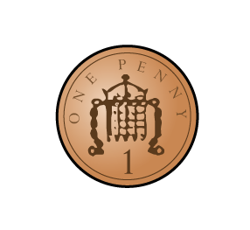
Challenge 1
How many coins?

Slide 4
Challenge 1
How many coins?

Slide 5
Challenge 1
How many coins?

Slide 6
Challenge 1
How many coins?

Slide 7
Challenge 1
Max has more than 5 coins.
He has fewer than 10 coins.
How many coins could Max have?

Slide 8
Answers
Max could have 6, 7, 8 or 9 coins

Slide 9
Points to discuss
Why might some children need help from BBC Children in Need?

Slide 10
Notes from BBC Children in Need
Why might some children need help from BBC Children in Need?
Some children are facing difficult challenges in their lives and need support. BBC Children in Need provides this support to those that need it. For example, some families may need help to buy food and stay warm. Some children may also need special medicine or help with caring for other members of their family.

Slide 11
Challenge 2
On Monday, Jo saves 1 penny.
On Tuesday, Jo saves 2 pennies.
On Wednesday, Jo saves 3 pennies.
Continue the pattern for Thursday and Friday.
How many pennies does Jo save altogether?

Slide 12
Answers
Jo saves 15 pennies altogether.

Slide 13
Points to discuss
What is BBC Children in Need?
How does BBC Children in Need help?

Slide 14
Notes from BBC Children in Need
What is BBC Children in Need?
BBC Children in Need is a charity that helps children across the UK who might be facing challenges and need some support.
How does BBC Children in Need help?
BBC Children in Need helps us to think about other children who might not be as fortunate as we are and encourages everyone to get involved and raise money to help others.

Slide 15

Challenge 3
The two buckets contain 10 coins altogether.
The red bucket has more coins than the green.
How many coins could each bucket contain?

Slide 16
Answers
9 coins 1 coin
8 coins 2 coins
7 coins 3 coins
6 coins 4 coins

Slide 17
Points to discuss
Have you ever noticed one of these?
Where might you see them?
What are they for?

Slide 18
Notes from BBC Children in Need
Where might you see them?
You might see these in your school, in a supermarket or even on the TV on BBC Children in Need day.
What are they for?
They are used as a way of collecting money for BBC Children in Need. People can put money in the buckets to show their support for BBC Children in Need. Most people put coins in the buckets because even a small amount can make a big difference.

Slide 19



Challenge 4
Where is 3?

Slide 20
Challenge 4
Where is 1?

Slide 21
Challenge 4
Where is 2?
Use counters and bowls to play with your friends!

Slide 22
Points to discuss
Have you ever helped someone?
How did it make you feel?
How do you feel when someone helps you?

Slide 23
Challenge 5
Steel completes a challenge for
BBC Children in Need.
He does 35 star jumps in 1 minute.
How many star jumps can you do in 1 minute?
Can you beat Steel?

Slide 24
Points to discuss
Have you ever raised money for
BBC Children in Need?
What could you do to raise money for
BBC Children in Need?

Slide 25
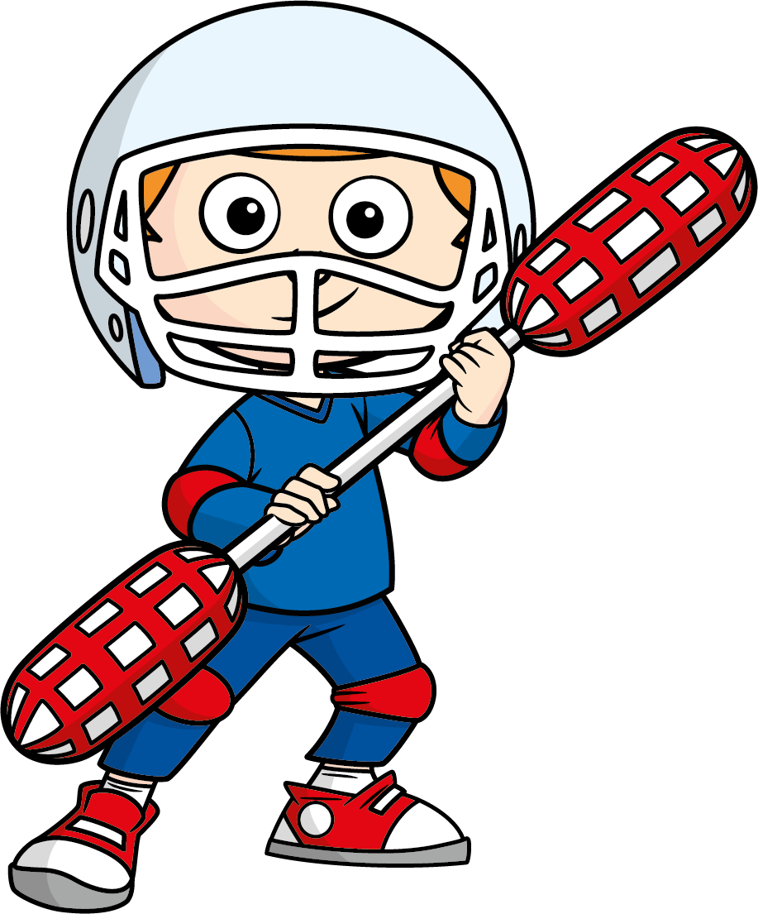



Can you organise an event to raise money for BBC Children in Need?
Remember, small amounts can make a big difference!

