Slide 1


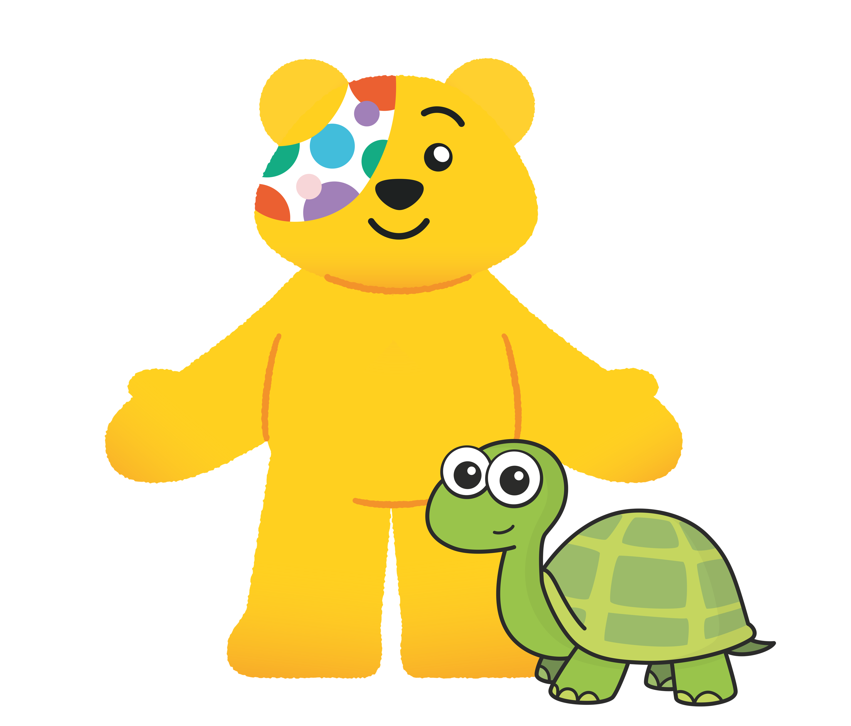


Slide 2
Guidance for teachers
These slides contain 5 daily maths challenges that can be used in the run up to BBC Children in Need day (Friday 15th November 2024). It would be useful to have coins available for some of the challenges so children can work practically.
Each challenge is followed by a page of suggested discussion prompts to raise children’s awareness of those needing help and how BBC Children in Need can make a difference.
The final discussion prompt encourages schools to consider how they could support BBC Children in Need. You can find some suggestions here or here.
We hope you enjoy the challenges. Let us know how you get on!

Slide 3


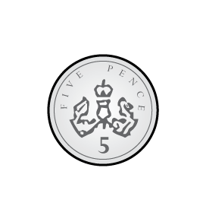
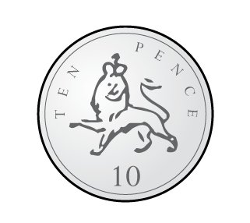
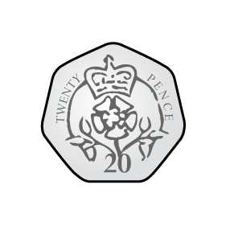
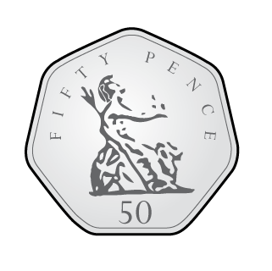
Challenge 1
Max has these coins.
He donates two of the coins to BBC Children in Need.
How much money could Max have donated?
Find as many answers as you can.

Slide 4
Answers
There are 15 possible answers.
3p, 6p, 11p, 21p, 51p
7p, 12p, 22p, 52p
15p, 25p, 55p
30p, 60p,
70p

Slide 5
Points to discuss
Why might some children need help from BBC
Children in Need?

Slide 6
Notes from BBC Children in Need
Why might some children need help from BBC Children in Need?
Some children are facing difficult challenges in their lives and need support. BBC Children in Need provides this support to those that need it. For example, some families may need help to buy food and stay warm. Some children may also need special medicine or help with caring for other members of their family.

Slide 7
Challenge 2
On Monday, Jo saves 1 penny.
On Tuesday, Jo saves 2 pennies.
On Wednesday Jo saves 3 pennies.
Continue the pattern for the rest of the week.
How many pennies does Jo save altogether?

Slide 8
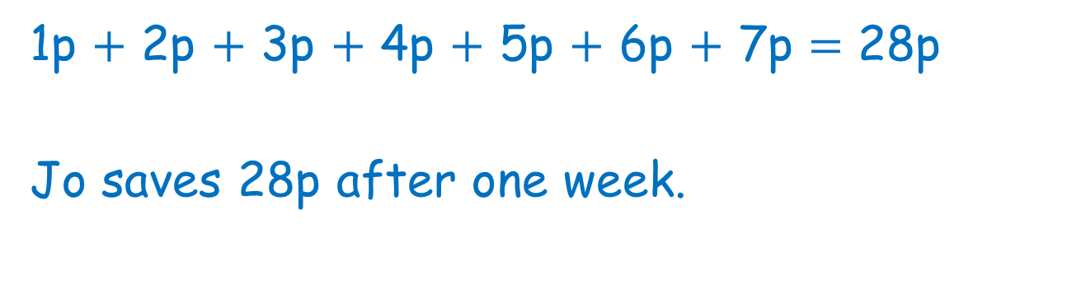
Answers
1p $+$ 2p $+$ 3p $+$ 4p $+$ 5p $+$ 6p $+$ 7p $=$ 28p
Jo saves 28p after one week.

Slide 9
Points to discuss
What is BBC Children in Need?
How does BBC Children in Need help?

Slide 10
Notes from BBC Children in Need
What is BBC Children in Need?
BBC Children in Need is a charity that helps children across the UK who might be facing challenges and need some support.
How does BBC Children in Need help?
BBC Children in Need helps us to think about other children who might not be as fortunate as we are and encourages everyone to get involved and raise money to help others.

Slide 11

Challenge 3
The green bucket has double the number of £1 coins as the red bucket.
How many £1 coins could each bucket contain?

Slide 12
Answers
Multiple possible answers, for example:
1 2
2 4
3 6

Slide 13
Points to discuss
Have you ever noticed one of these?
Where might you see them?
What are they for?

Slide 14
Notes from BBC Children in Need
Where might you see them?
You might see these BBC Children in Need buckets in your school, in a supermarket or even on the TV on BBC Children in Need day.
What are they for?
They are used as a way of collecting money for BBC Children in Need. People can put money in the buckets to show their support for BBC Children in Need. Most people put coins in the buckets because even a small amount can make a big difference.

Slide 15
Challenge 4
Ron gives 25p to BBC Children in Need.
What coins could Ron have used if he gave…
2 coins?
3 coins?
4 coins?
5 coins?

Slide 16
Answers
Multiple possible answers, for example:
2 coins
3 coins
4 coins
5 coins

Slide 17
Points to discuss
Have you ever helped someone in need?
How does it make you feel when you help others?
How would you feel if someone helped you when
you needed help?

Slide 18
Challenge 5
Steel can do 35 star jumps in 1 minute.
How many star jumps can he do in 2 minutes?
How many star jumps can you do in 1 minute?
Can you beat Steel?

Slide 19
Answers
Steel can do 70 star jumps in 2 minutes.

Slide 20
Points to discuss
Have you ever raised money for BBC Children in Need?
What sort of things could you do to raise money for BBC Children in Need?

Slide 21




Can you organise an event to raise money for
BBC Children in Need?
Remember, small amounts can make a big difference!

