Slide 1


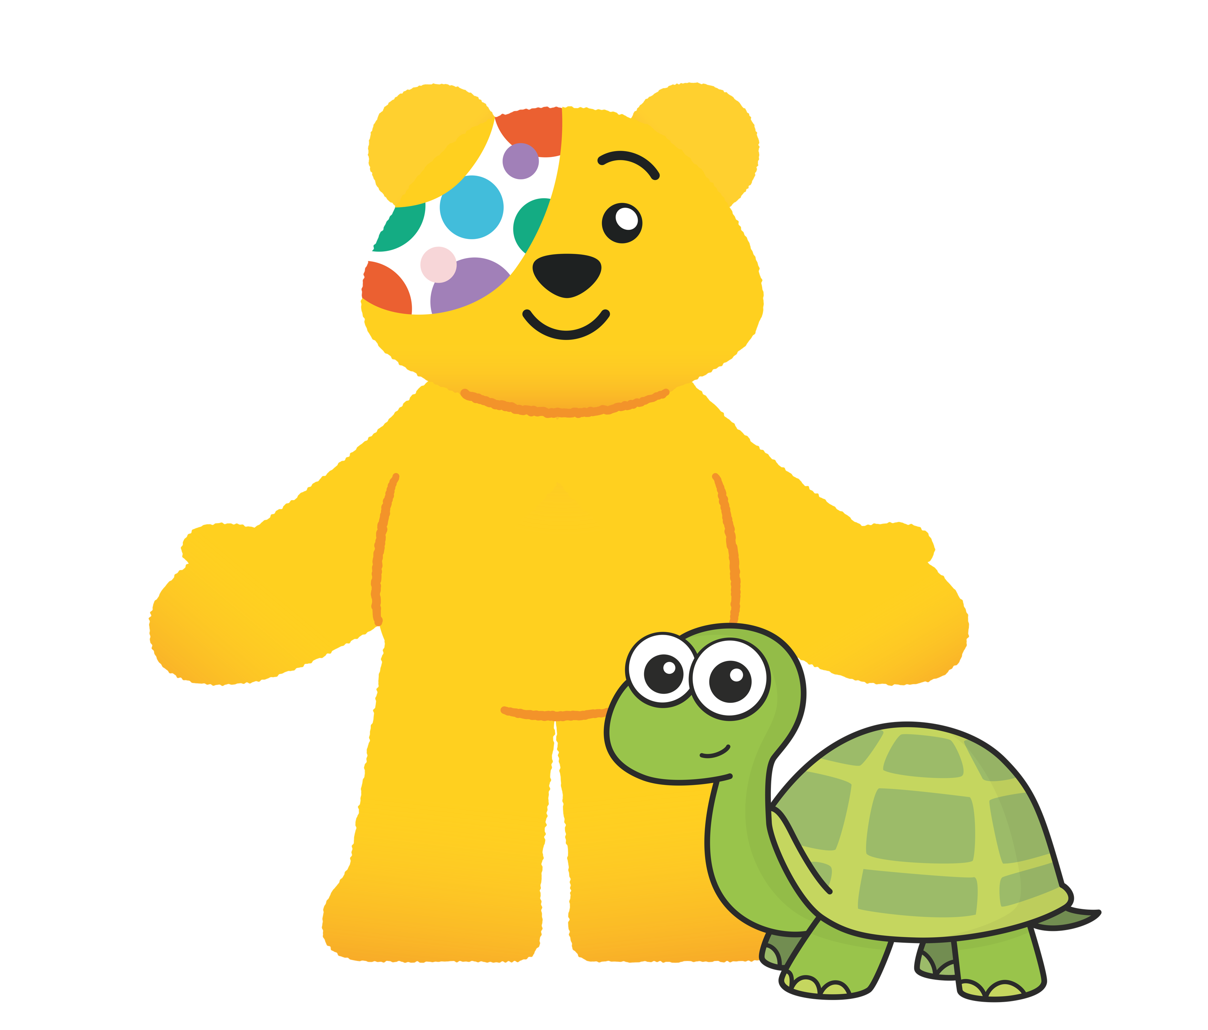


Slide 2
Guidance for teachers
These slides contain 5 daily maths challenges that can be used in the run up to BBC Children in Need day (Friday 15th November 2024). It would be useful to have coins available for some of the challenges so children can work practically.
Each challenge is followed by a page of suggested discussion prompts to raise children’s awareness of those needing help and how BBC Children in Need can make a difference.
The final discussion prompt encourages schools to consider how they could support BBC Children in Need. You can find some suggestions here or here.
We hope you enjoy the challenges. Let us know how you get on!

Slide 3
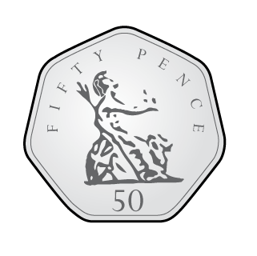



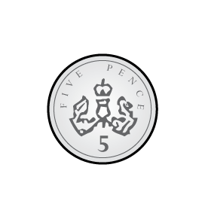
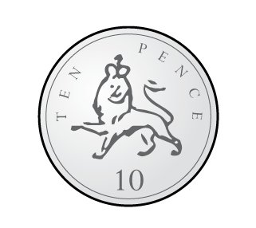
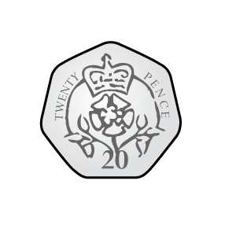

Challenge 1
Max has these coins.
He donates two coins to BBC Children in Need.
How much money could Max have donated?
There are 28 different possible answers.
Can you find them all?

Slide 4
Answers
3p, 6p, 11p, 21p, 51p, £1 and 1p, £2 and 1p
7p, 12p, 22p, 52p, £1 and 2p, £2 and 2p
15p, 25p, 55p, £1 and 5p, £2 and 5p
30p, 60p, £1 and 10p, £2 and 10p
70p, £1 and 20p, £2 and 20p
£1 and 50p, £2 and 50p
£3

Slide 5
Points to discuss
What is BBC Children in Need?
Why might some children need help?
How does BBC Children in Need help?

Slide 6
Notes from BBC Children in Need
What is BBC Children in Need?
BBC Children in Need is a charity that helps children who need it the most.
Why might some children need help?
Some children are facing difficult challenges in their lives and need support from BBC Children in Need. For example, some families may need help to buy food and stay warm. Some children may also need special medicine or help with caring for other members of their family.
How does BBC Children in Need help?
BBC Children in Need helps us to think about other children that might not be as fortunate as we are and encourages everyone to get involved and raise money to help others.

Slide 7
Challenge 2
On the 1st November, Jo saves 2p.
On the 2nd, Jo saves 4p.
On the 3rd, Jo saves 6p.
Jo continues to save 2p more each day.
How much does Jo save in total after 1 week?
How much does Jo save in total after 2 weeks?

Slide 8
Answers
Jo saves 56p in 1 week.
Jo saves £2 and 10p in 2 weeks.

Slide 9
Points to discuss
Why is it important for BBC Children in Need to
receive donations?
Do small donations make a difference?

Slide 10
Notes from BBC Children in Need
Why is it important for BBC Children in Need to receive donations?
BBC Children in Need is a fundraiser and grant maker. That means that we ask the public to raise and donate lots of money so that we can make a difference to the children and young people who need us most – right across the UK.
Do small donations make a big difference?
Yes, small donations can make a big difference to children who need our support. If everyone in your class brought in £1 you could donate £30 to BBC Children in Need. This could pay for art supplies for a creative group session for children in care, supporting them to express their emotions and build confidence.

Slide 11


Challenge 3
These collection buckets together contain £21
Each bucket contains a different odd number of £1 coins.
How many £1 coins could each bucket contain?
Can you find all the possible answers?

Slide 12
Answers
There are 7 possible answers:
1, 3, 17
1, 5, 15
1, 7, 13
1, 9, 11
3, 5, 13
3, 7, 11
5, 7, 9

Slide 13
Points to discuss
Have you ever noticed one of these?
Where might you see them?
What help does BBC Children in Need offer in your local area?
Click here to find out!

Slide 14
Notes from BBC Children in Need
Where might you see them?
You might see these BBC Children in Need buckets in your school, in a supermarket or even on the TV on BBC Children in Need day.
What help does BBC Children in Need offer in your local area?
Use the BBC Children in Need’s interactive map to see what help is offered in your local area.

Slide 15
Challenge 4
Kim gives 55p to BBC Children in Need.
What coins could Kim have used if she gave…
2 coins?
4 coins?
5 coins?
Any number of coins up to 10 coins?

Slide 16
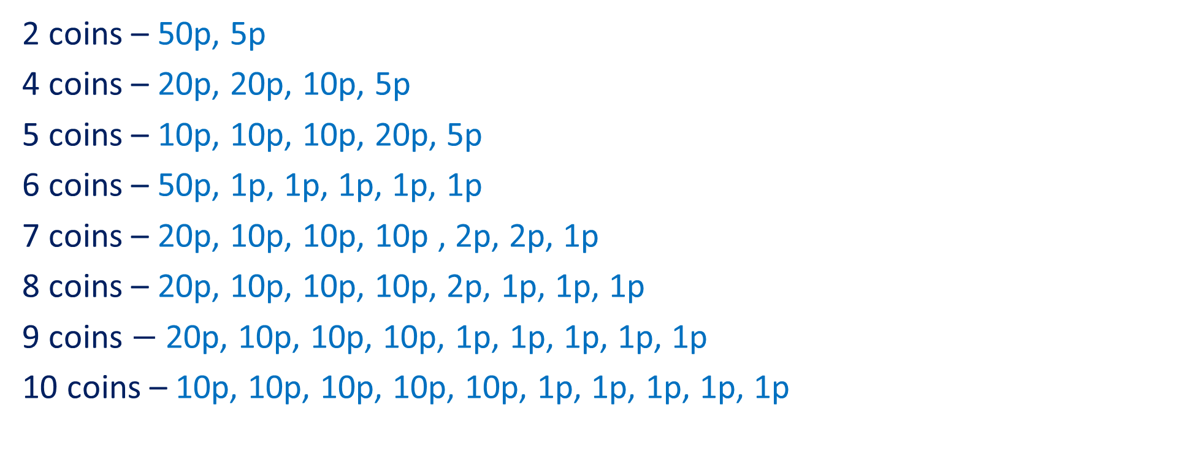
Answers
*Other answers are possible
2 coins – 50p, 5p
4 coins – 20p, 20p, 10p, 5p
5 coins – 10p, 10p, 10p, 20p, 5p
6 coins – 50p, 1p, 1p, 1p, 1p, 1p
7 coins – 20p, 10p, 10p, 10p , 2p, 2p, 1p
8 coins – 20p, 10p, 10p, 10p, 2p, 1p, 1p, 1p
9 coins $−$ 20p, 10p, 10p, 10p, 1p, 1p, 1p, 1p, 1p
10 coins – 10p, 10p, 10p, 10p, 10p, 1p, 1p, 1p, 1p, 1p

Slide 17
Points to discuss
Have you ever helped fundraise for BBC Children in Need?
Apart from giving money, what other ways can you help people?
How does it make you feel when you help others?

Slide 18
Challenge 5
Legend is taking part in a sponsored swim to raise
money for BBC Children in Need.
Here is his sponsor form.
Legend swims 8 lengths of a 25m pool.
How much money does he raise?
Gladiator | Amount
Fire | 10p per length
Nitro | £5 total
Fury | £2 per length
Apollo | 1p per metre

Slide 19

Answers
Fire 8 $×$ 10p $=$ 80p
Nitro £5 total
Fury 8 $×$ £2 $=$ £16
Apollo 8 $×$ 25 m $=$ 200 m 200 $×$ 1p $=$ £2
£16 $+$ £5 $+$ £2 $+$ 80p $=$ £23 and 80p
Total raised is £23 and 80p

Slide 20
Points to discuss
Have you ever taken part in a sponsored event?
What does it mean to be sponsored?
What sort of things could you do to raise money
for BBC Children in Need?

Slide 21
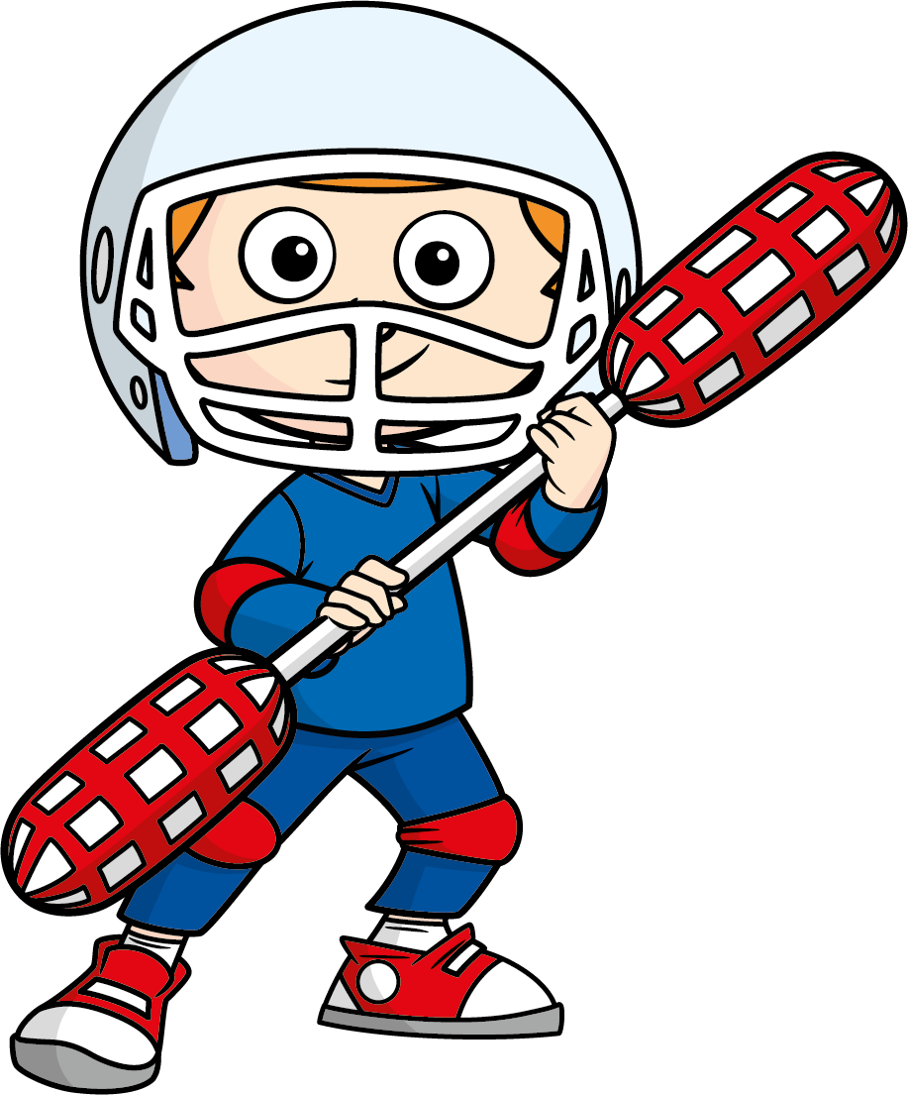



Can you organise an event to raise money for
BBC Children in Need?
Remember, small amounts can make a big difference!

